Slide 1
Input-Output Devices
Lecture 3

Slide 2
I/O Devices
The I/O Devices provide the means of communication between the computer and the other world.
Input devices are used to enter data from the outside world into the primary storage, and output devices supply the result of processing from the primary storage to the user
Results of processing in human acceptable form
Input Data
From external
world
Input Device
CPU and Memory
Output Device
Input Data coded in internal form
Processed data in internal form

Slide 3
INPUT Devices
An input device is an electromechanical device, which accept data from outside world and translates them into a form, which the computer can interpret.
Input devices can be classified into the following categories.
  Keyboard devices
  Point-and-Draw devices
  Data Scanning Devices
  Voice recognition devices
  Vision based devices
  Electronic Card based devices
  Digitizer.

Slide 4
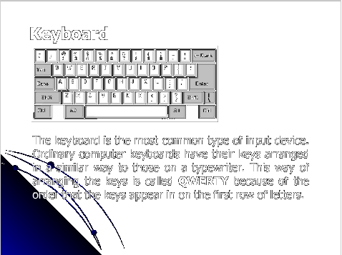
Keyboard

Slide 5
Keyboard
A keyboard is a lot like a mini computer. It has its own processor and circuitry that carries information to and from that processor. A large part of this circuitry makes up the key matrix. The key matrix is a grid of circuits underneath the keys. When you press a key, it presses a switch, completing the circuit and allowing a tiny amount of current to flow through. If you press and hold a key, the processor recognizes it as the equivalent of pressing a key repeatedly. When the processor finds a circuit that is closed, it compares the location of that circuit on the key matrix to the character map in its read-only memory (ROM).

Slide 6
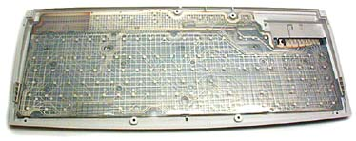
Keyboard

Slide 7
Point-and-Draw Devices
With the creation of Graphical User interface (GUI), it become difficult to work with keyboard.
To work with graphic Icons and menus, Pointing devices such as Mouse, track ball, joystick, light pen and touch screen were invented .
Later it was realized that many of these devices could also be very effectively used to create graphic elements on the screen.

Slide 8
Mouse
Mouse is the most popular point-and-draw device.
A ball inside the mouse touches the desktop and rolls when the mouse moves. Two rollers inside the mouse touch the ball. One of the rollers is oriented so that it detects motion in the X direction, and the other is oriented 90 degrees to the first roller so it detects motion in the Y direction. When the ball rotates these rollers rotate as well.

Slide 9
Optical Mouse
The optical mouse actually uses a tiny camera to take 1,500 pictures every second. Able to work on almost any surface, Working is a follows:
The mouse has a small, red light-emitting diode (LED) that bounces light off that surface onto a complimentary metal-oxide semiconductor(CMOS) sensor.
The sensor sends each image to a digital signal processor (DSP) for analysis.
The DSP, operating at 18 MIPS (million instructions per second), is able to detect patterns in the images and examines how the patterns have moved since the previous image.
Based on the change in patterns over a sequence of images, the DSP determines how far the mouse has moved.

Slide 10
Optical Mouse
Optical mice have several benefits over track-ball mice:
No moving parts means less wear and a lower chance of failure.
There's no way for dirt to get inside the mouse and interfere with the tracking sensors.
They don't require a special surface, such as a mouse pad.

Slide 11
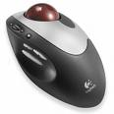
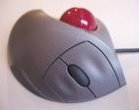
Trackball
Trackball is a pointing device, which is similar to mouse.
To move the graphics courser around the screen, the ball is rolled with the finger.

Slide 12
Joystick
The main usage of joystick is to play computer games by controlling the way that something moves on the screen
To make the movement of the spherical ball easier, a stick is mounted on it.
Joystick can be used to control movement from side-to-side, up-and-down and diagonally.
A joystick will also always have at least one button on it which can be used to make something happen like making a character in a game jump or fire a gun.

Slide 13
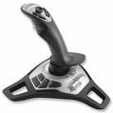
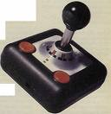
Joystick

Slide 14
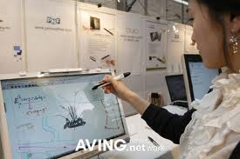
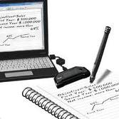
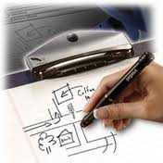
Electronic Pen
Electronic pen is also in the category of point-and-draw device.
In a pen based system, you hold the pen in your hand, and directly point with it on the screen to select menu items or icons.
Also, can draw graphics on the screen.

Slide 15
Touch Screen
Is the most simple and easiest to learn of all input devices
Touch screen enables the user to choose from available options by simply touching their finger on the desire icon or menu displayed on the screen.

Slide 16
Electronic Card Reader
Electronic cards and their associated readers offer another means of direct data entry in a computer system.
An electronic card reader, which is normally connected to a computer, is used to read the data encoded on an electronic card , and transfer it to the computer for further processing.
Example
  ATM machine.
  RFID Readers

Slide 17
RFID
A Radio-Frequency IDentification system as three parts:
1. A scanning antenna
2. A transceiver with a decoder to interpret the data
3. A transponder - the RFID tag - that has been programmed with information.
The scanning antenna puts out radio-frequency signals in a relatively short range. The RF radiation does two things:
1. It provides a means of communicating with the transponder
2. It provides the RFID tag with the energy to communicate
The scanning antennas can be permanently affixed to a surface; handheld antennas are also available. They can take whatever shape you need; for example, you could build them into a door frame to accept data from persons or objects passing through.
When an RFID tag passes through the field of the scanning antenna, it detects the activation signal from the antenna. That "wakes up" the RFID chip, and it transmits the information on its microchip to be picked up by the scanning antenna.

Slide 18
Voice Recognition Devices
Voice recognition devices are input devices, which allow person to input data to a computer system by speaking to it.
However, currently voice recognition system have limited success, because interpretation by a machine of the large numbers of words in the vocabulary of a language is difficult.
The major difficulty has bee that people speak with different accents, different tone or pitch of the voice.

Slide 19
Vision-Input System
A vision-input System allows a computer to accept input just by seeing an object.
Vision-input device consists of camera and follows the following steps to recognize a given object.
  The Digital camera is focused on the input object to take a picture of the object.
  The camera creates an image of the object in digital form, so that it can be stored and interpreted by the computer.
  The Digitized image of the object is matched against similarly formed per-stored images in the computer.
  Depending on whether a match is found or not, the system takes an appropriate action.

Slide 20
Digitizer
A digitizer is an input device, which is used for converting pictures, maps and drawings into digital form for storage in computers.
A digitizer consists of a digitizing tablet associated with stylus.
The digitizing tablet is a flat surface, which contains hundreds of fine copper wires forming a grid. Each copper wire receive electric plus.
The Stylus is connected to a tablet, and can be pressed down at a point on a tablet to input the (x,y) coordinates of the point.

Slide 21
Digitizer
When the stylus is moved on the tablet, the cursor on the computer screen moves simultaneously to the corresponding position on the screen to provide visual feedback to the operator.
Digitizers are commonly used in the area of Computer Aided Design (CAD) by architects and engineers to design cars, buildings, medical devices, robots, mechanical parts,etc.

Slide 22
Data Scanning Devices
Data scanning devices are input devices, which are used for direct data entry into the computer system from source documents.
Data Scanning Devices have following characteristics
  They eliminate some of the duplication of human effort required to get data into the computer.
  The reduction in human intervention improves data accuracy, and can increase the timeliness of the information processed.
  Since scanners are direct data devices, they demand high quality of input documents.
  With these devices, form design and ink specification may become more critical than is the case when people enter from the forms.

Slide 23
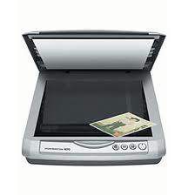
Image Scanner
An image scanner is an input device, which translate paper documents into an electronic format, which can be stored in a computer.
The input documents may be typed text, pictures, graphics, or even handwritten material.
Two types of image scanners
  Flatbed scanner
  Hand-held scanner

Slide 24
Flatbed Scanner
Flatbed scanners also called desktop scanners, are the most versatile and commonly used scanners.
Flatbed scanner is like a copy machine, which consists of a box having a glass plate on its top and a lid that covers a glass plate.
The document to be scanned is placed upside down on the glass plate.
The light source is situated below the glass plate, and moves horizontally from left to right when activated. After scanning one line, the light beam moves up a little, and scans the next line. The process is repeated for all the lines.

Slide 25
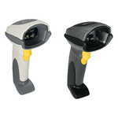
Hand-held Scanner
Handheld scanners use the same basic technology as a flatbed scanner, but rely on the user to move them instead of a motorized belt. This type of scanner typically does not provide good image quality.
To scan a document, the scanner is
slowly dragged from one end of the
document to its other end, with its lights on.
The scanner has to be dragged very
steadily and carefully over the documents, otherwise the conversion of the documents into its equivalent bit map will not be correct.

Slide 26
Optical Character Recognition (OCR) Device
When image scanner are used for inputting text documents, they have the following two limitations.
  Since the input documents is stored as an image, it is not possible to do any word processing of the documents.
  The storage required for storing the document as an image is much more than that required for storing the same document as a text.
The OCR technology is used to overcome these limitations.
In this case, the scanner is equipped with a character recognition software, which converts the bit map images of characters to equivalent ASCII codes.

Slide 27
Optical Mark Reader (OMR)
These scanner are capable of recognizing a pre-specified type of mark made by pencil or pen.
The actual technique used by an OMR device for recognition of marks involves focusing a light on the page being scanned, and detecting the reflected light pattern from the marks.
Pencil marks made with a soft lead pencil reflect the light, enabling the reader to determine which responses are marked.

Slide 28
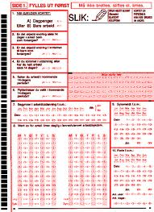
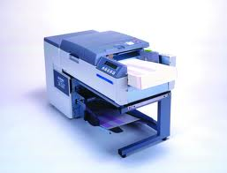
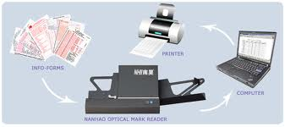
OMR

Slide 29
Bar Code Reader
Data coded in the form of small lines are known as bar codes.
Bar codes represent alphanumeric data by a combination of adjacent vertical lines by varying their width and spacing between them.
Bar code reader is a device , which is used for reading bar-coded data.
It scans a bar-code image, and converts it into an alphanumeric value, which is fed to a computer to which the bar code reader is connected.

Slide 30
Bar-Code Reader
A bar-code reader uses a laser beam scanning technology.
There are a variety of bar-coding systems. The most commonly used system in USA is Universal Product Code (UPC).
The UPC bar-code patterns are decoded as 10 digits. The first 5 of these digits identify the manufacturer of the product and the next 5 digits identify a specific product of the manufacturer.

Slide 31
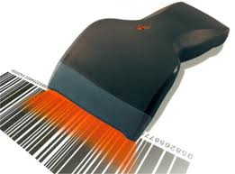
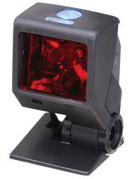
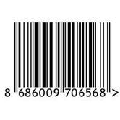
Bar-Code Reader

